Slide 1

Convolutional Layers
And
Filters in Image Recognition
Lionel DeLuna
Masson Lopez
Mohammad Sufyaan
Morgan Germany
Silas Caporal

Slide 2
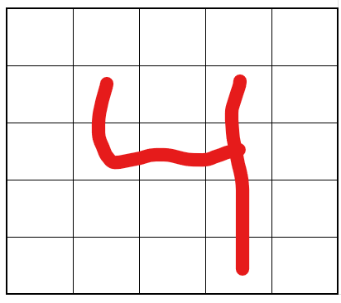
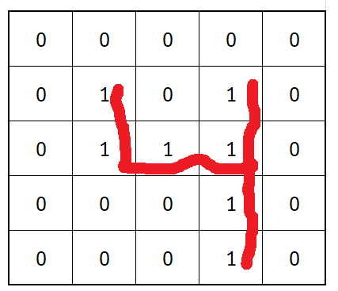
Image of the Number 4
Image of the Number 4

Slide 3
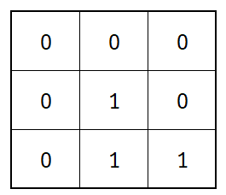
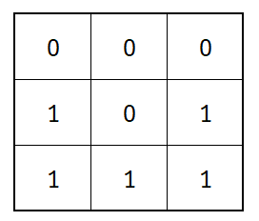
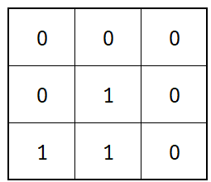
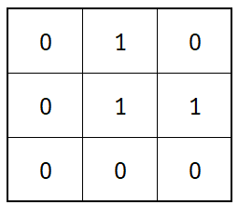
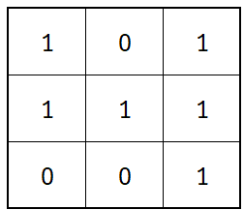
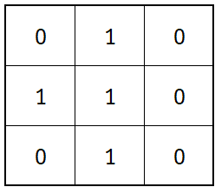
Sliding Filter for Vertical Edges
Sliding Filter for Horizontal Edges

Slide 4
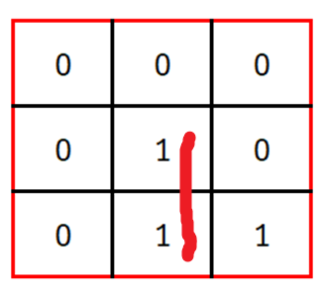
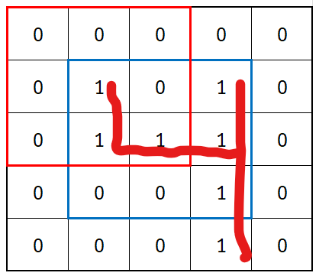
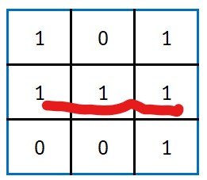
Sliding Filter for Vertical Edges
Sliding Filter for Horizontal Edges

Slide 5
